Slide 1

PIZZA DELIVERY APP BY SALESFORCE DEVELOPER
Team Members
KRISHNARAJ S (IV - CSBS)
DHARMARAJ R (IV - CSBS)
ARAVINTH N (IV - CSBS)
DHARUN M P (IV - CSBS)
GUIDE : Venkata Ramanan AP/CSBS
MENTOR : Venkata Ramanan AP/CSBS
EVALUATOR : Venkata Ramanan AP/CSBS

Slide 2
What is Salesforce ?
Salesforce is a popular cloud-based customer relationship management (CRM) platform that helps businesses manage their relationships and interactions with customers and potential customers. It offers a wide range of tools and features for sales, marketing, customer service, and more.
Salesforce allows businesses to store customer data, track leads and opportunities, automate various tasks, and provide a unified view of customer information to improve overall business efficiency and customer satisfaction. It is widely used across various industries to streamline processes and enhance customer engagement.

Slide 3
Pizza Delivery App
Enjoy the ultimate pizza experience with our Pizza Delivery App powered by Salesforce CRM.
Order your favorite pizzas with a few taps, track your delivery in real-time, and receive personalized promotions.
Our app seamlessly integrates order management, ensuring hot, delicious pizzas are delivered to your doorstep. Easy, efficient, and delicious!
In this project, we have 14 milestones to successfully complete the pizza delivery app.

Slide 4
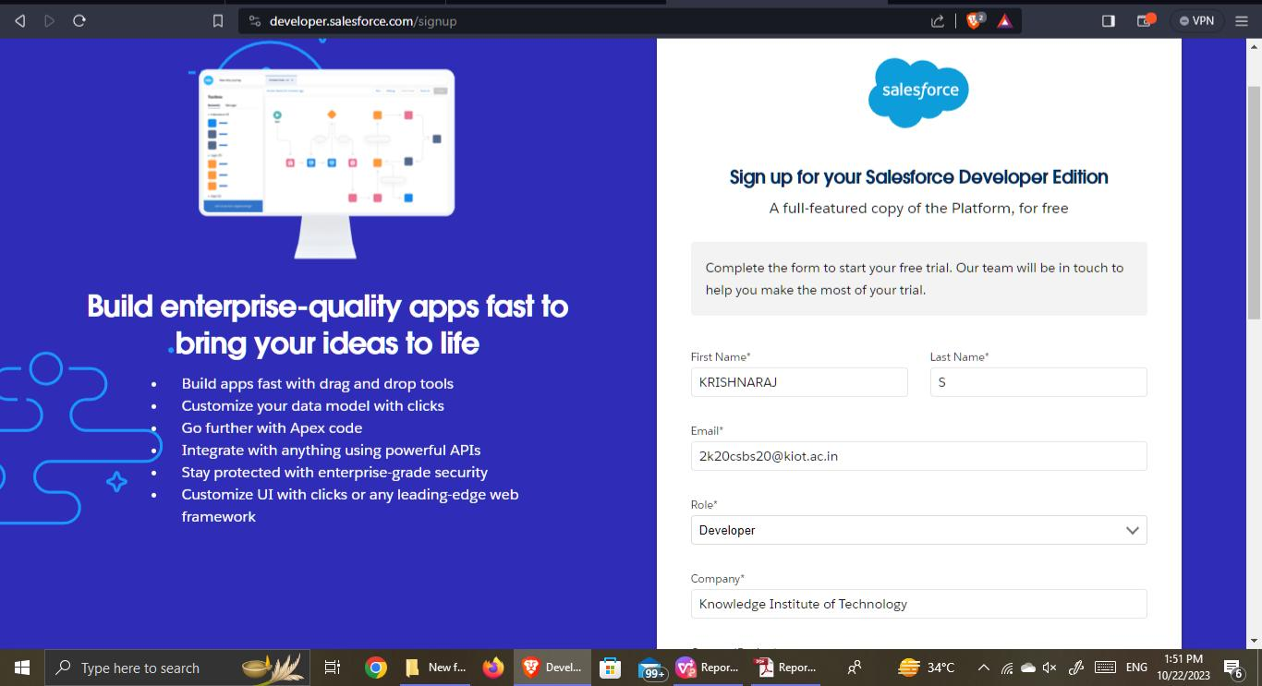
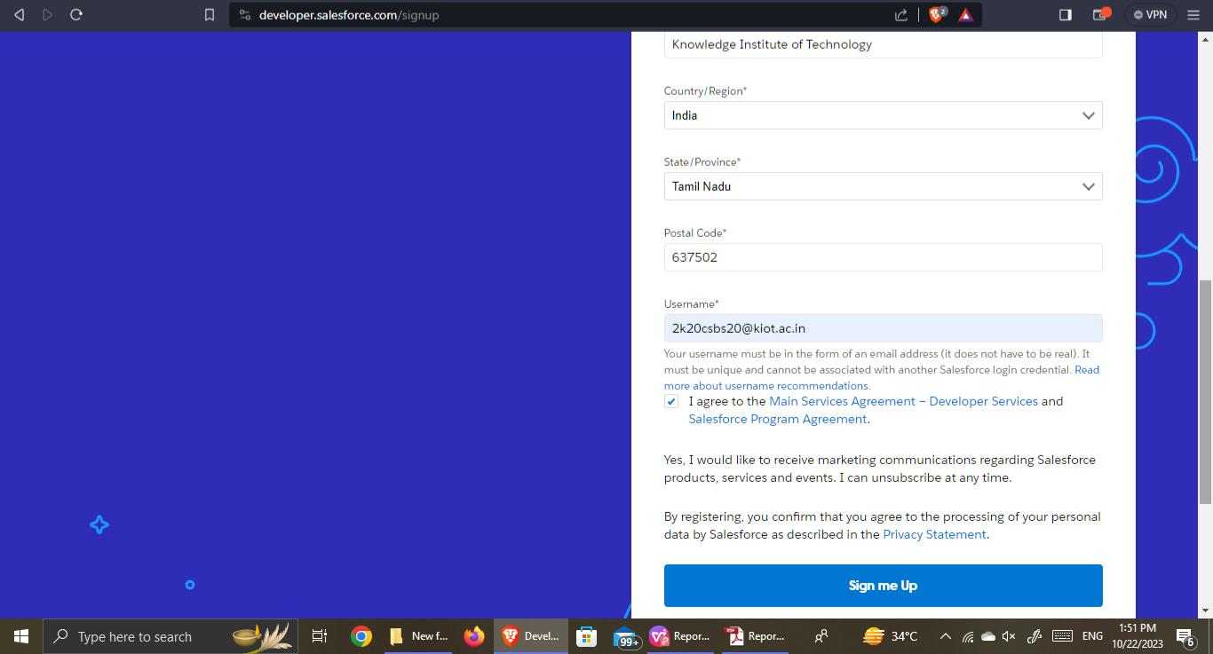
1. Creation of Developer Account
A Developer org has all the features and licenses you need to get started with Salesforce.1.Search developer.salesforce.com/signup

Slide 5
2. Object Creation
What is an Object?
In Salesforce, an object is a data structure representing a table storing specific information, comprising fields and records, crucial for efficient data management and organization.
Two Types
Standard Objects: - Predefined entities like Accounts and Contacts in Salesforce, catering to common business needs without extensive customization.
Custom Objects: - User-defined entities allowing businesses to create tailored data structures, enabling unique data storage and specialized application development.

Slide 6
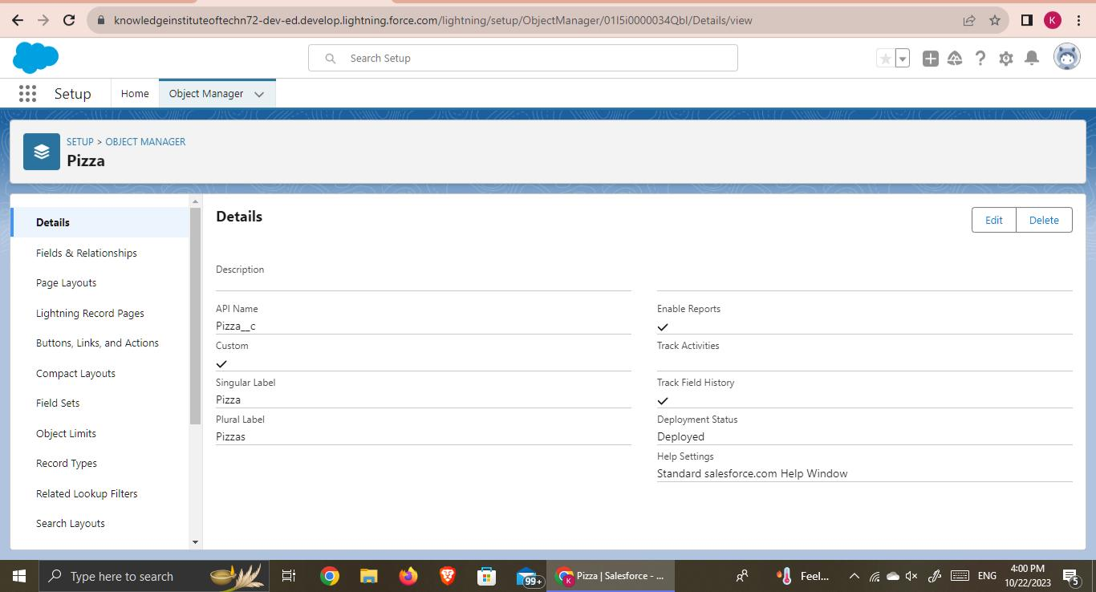
In this Application we use some Custom Objects
EveryDay Values
Beverages
Customer Details
Best sellers
New launches
Pizzas
Mode of payments
Reports

Slide 7
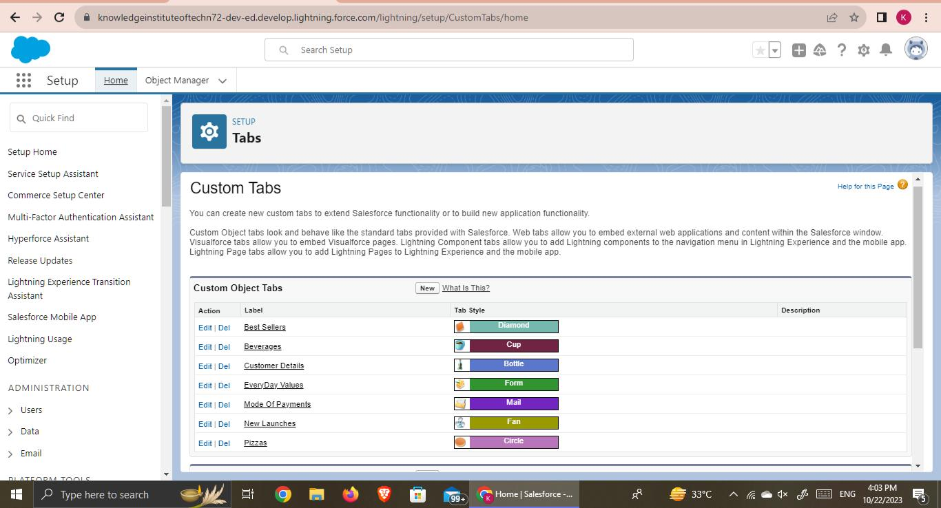
3. Tabs Creation
Tabs in Salesforce are sections for navigation, providing access to data and functions. They organize standard, custom objects, Visualforce, Lightning components, and web pages.

Slide 8
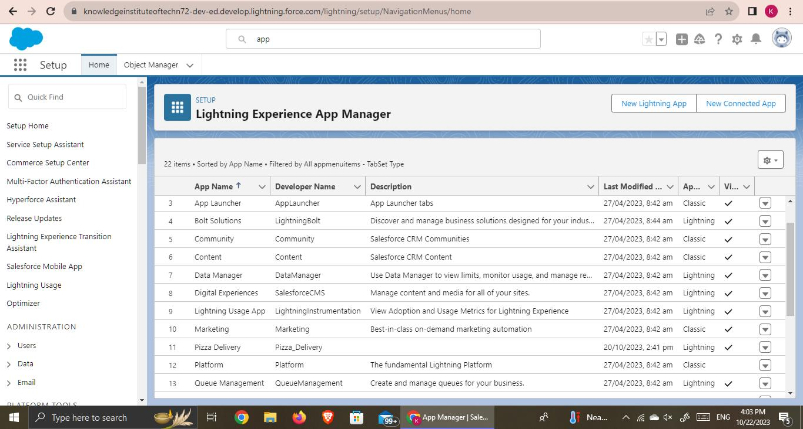
4. Create App
Salesforce offers standard (Sales Cloud), custom, and third-party apps through AppExchange.
These include mobile, community, and integration apps, empowering businesses with versatile solutions for CRM, collaboration, and efficiency.

Slide 9
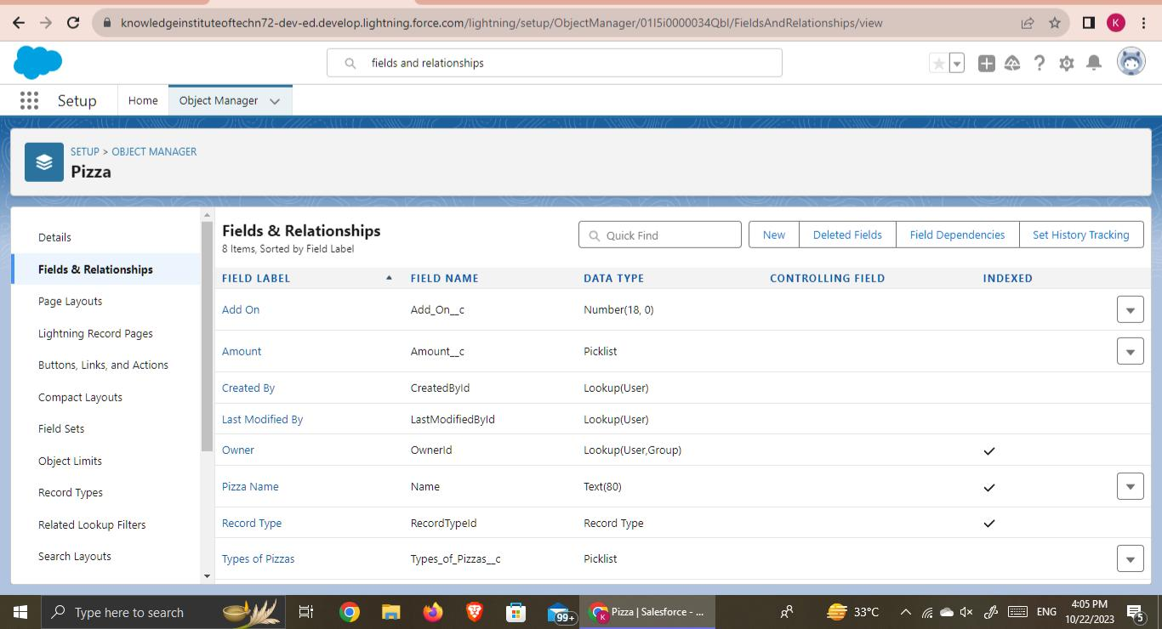
5. Fields & Relationships
Salesforce fields store diverse data types: text, numbers, dates, picklists, checkboxes, formulas, lookups, and more.
They organize information within records, crucial for efficient CRM management.

Slide 10
6. Record Types
Record types in Salesforce enable customized user experiences.
They define distinct page layouts, picklist values, and business processes based on user profiles.
By assigning different record types to records, organizations can streamline data entry, ensuring relevant information is captured for various contexts.
This flexibility enhances user efficiency and allows businesses to adapt Salesforce to their specific needs, optimizing workflow and data management across diverse teams and processes.

Slide 11
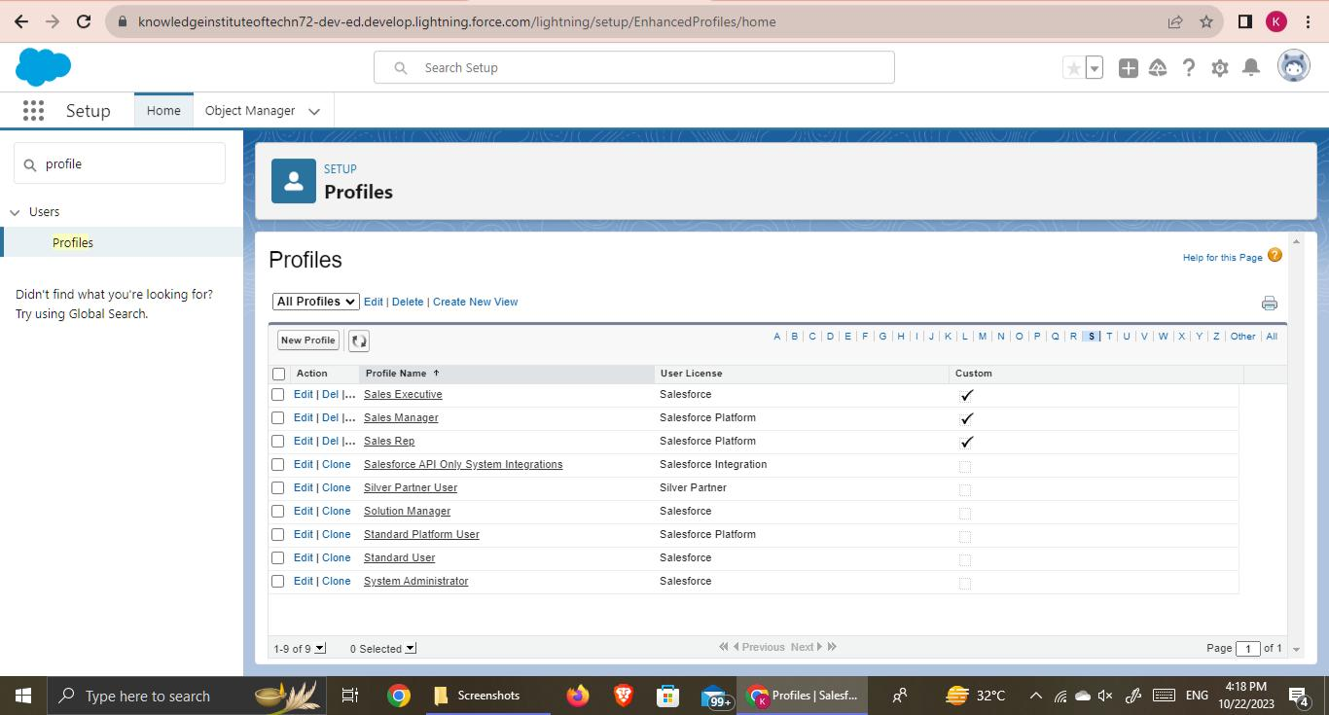
7. Profile
Salesforce profiles manage user permissions, controlling access to objects, fields, and record actions.
They’re crucial for data security and maintaining organization-specific data integrity and functionality.

Slide 12
8. User Adoption
User adoption in Salesforce refers to the extent to which employees effectively use Salesforce within an organization.
It’s crucial for maximizing the benefits of the platform.
Successful adoption involves comprehensive training, intuitive design, clear communication of its benefits, and addressing user concerns.
Regular feedback, support, and ongoing training can further enhance adoption rates among users.

Slide 13
9. Organization Wide Default (OWD)
OWD refers to the baseline level of access that all users in an organization have to records, regardless of the ownership or sharing settings. OWD settings determine the default level of access for objects in Salesforce, such as Accounts, Contacts, Opportunities, etc. There are three main OWD options:
1. Private: In this setting, only the record owner and users above them in the role hierarchy can access the record. 2. Public Read-Only: All users can view the records, but only the owner and users above them in the hierarchy can edit. 3. Public Read/Write: All users can view and edit the records.

Slide 14
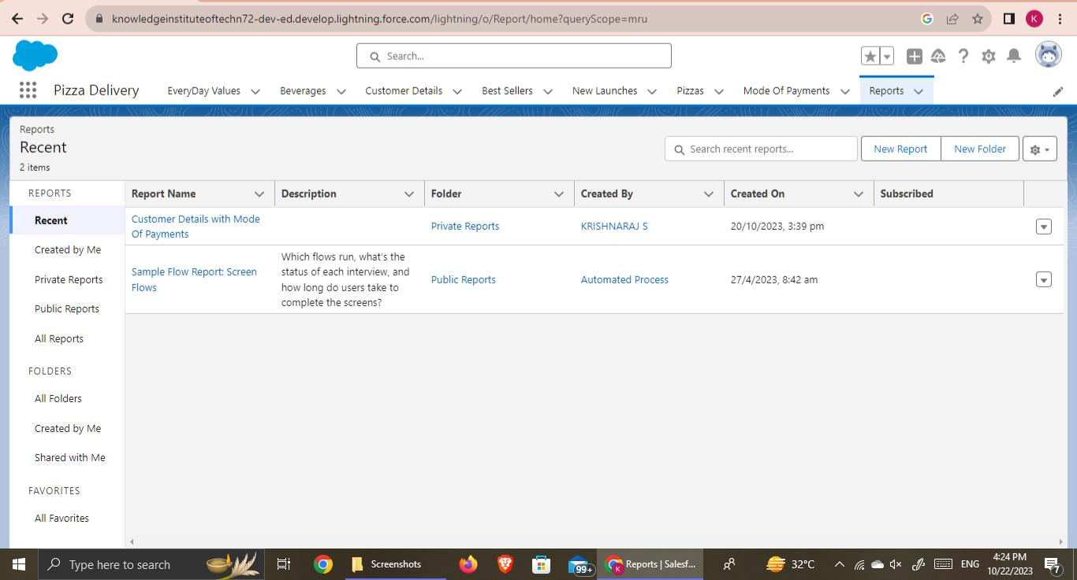
10. Reports
Salesforce reports analyze data with customizable formats, filters, and charts.
Users create insightful reports and dashboards, enabling informed decisions and enhancing overall organizational efficiency.

Slide 15
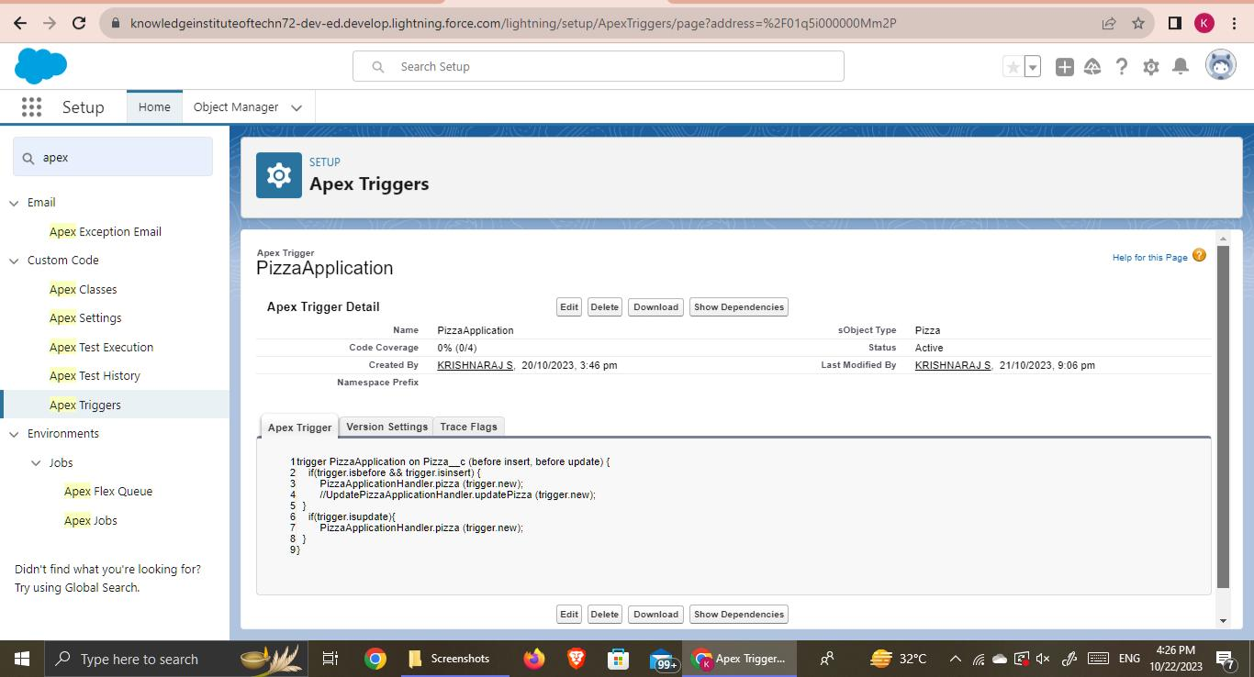
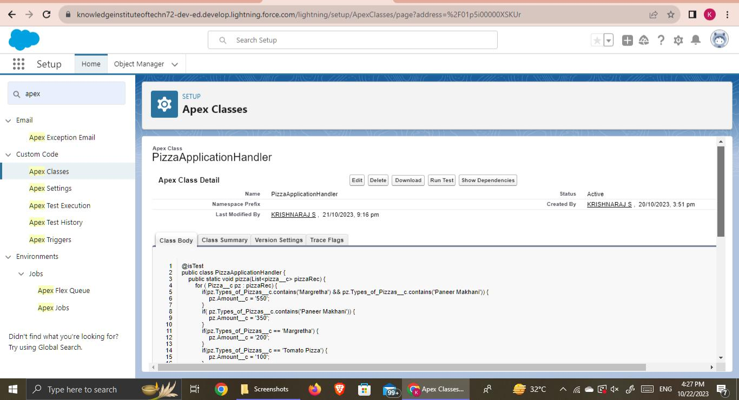
11. Apex Triggers
Apex triggers in Salesforce execute custom code before/after events like record insertion, updating. They handle bulk operations, enforce rules, and ensure data integrity efficiently.

Slide 16
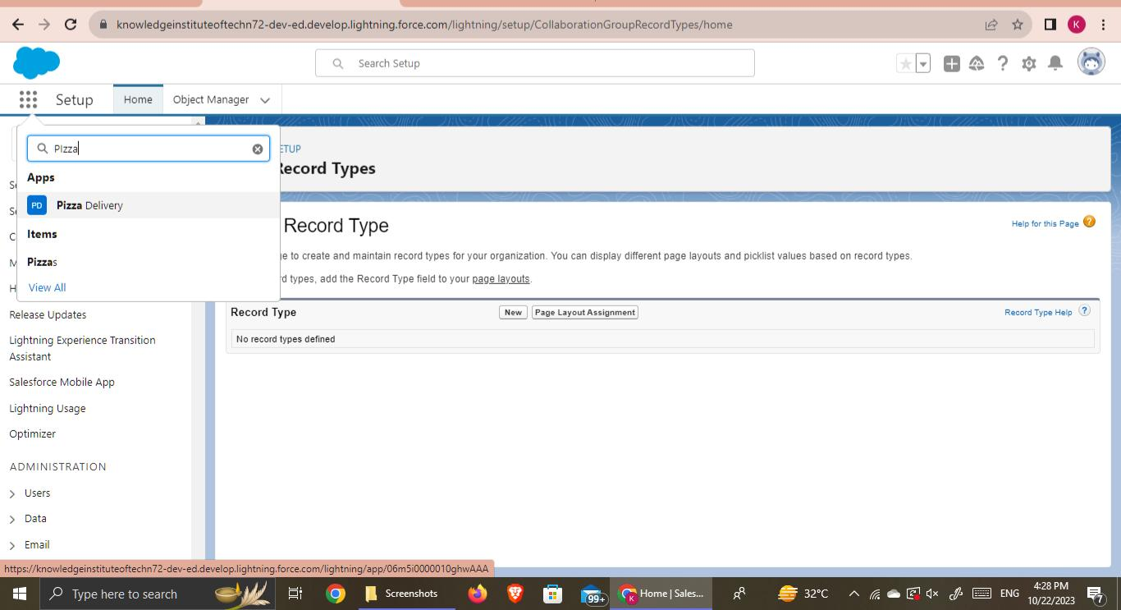
App Launcher

Slide 17
THANK YOU

